Slide 1
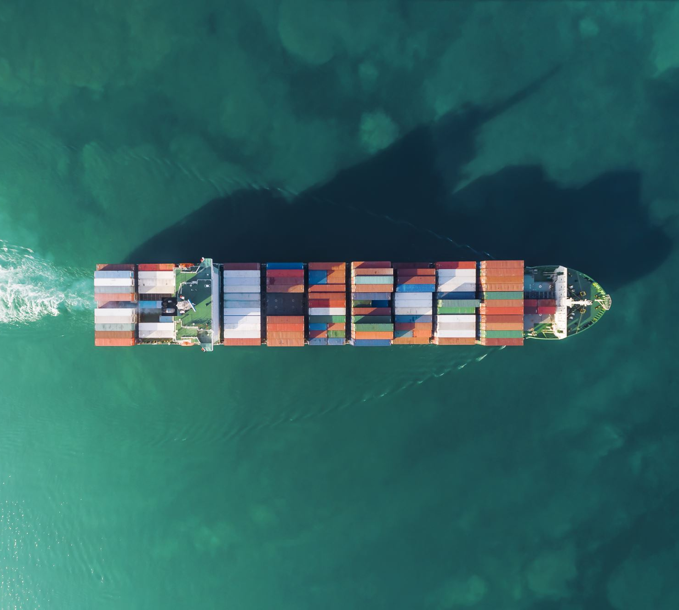

Analyzing Ocean Carrier Alliances
Transportation Research Group
School of Economic Sciences
College of Agriculture and Natural Resource Sciences

Slide 2
What are Ocean Carrier Alliances (OCAs)?
Cooperative sharing agreements between maritime freight carriers
e.g., Maersk will carry some cargo for Mediterranean and vice versa
OCAs allow carriers to offer additional services (e.g., additional lanes) and more efficiently allocate capacity.
Carriers can utilize larger ships by filling volume from other carriers.
The impact on shippers/consumers is not well studied.
For example, carriers sometimes offer very low prices on otherwise-used capacity in order to minimize empty haul. Under an alliance agreement, this capacity might be sold at normal prices to another carrier.

Slide 3
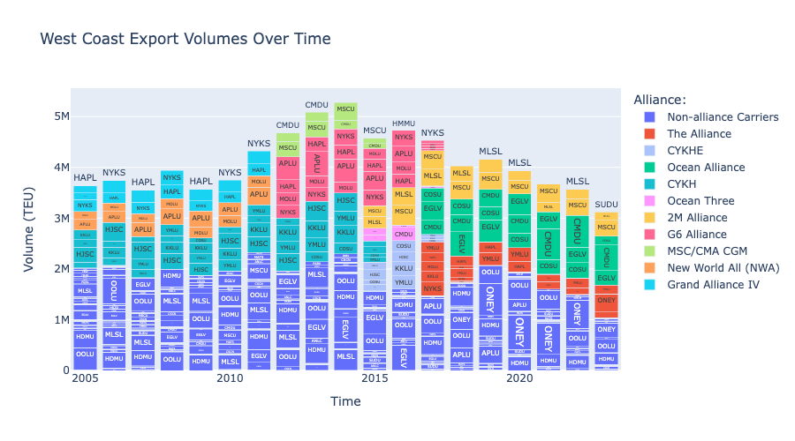

Slide 4
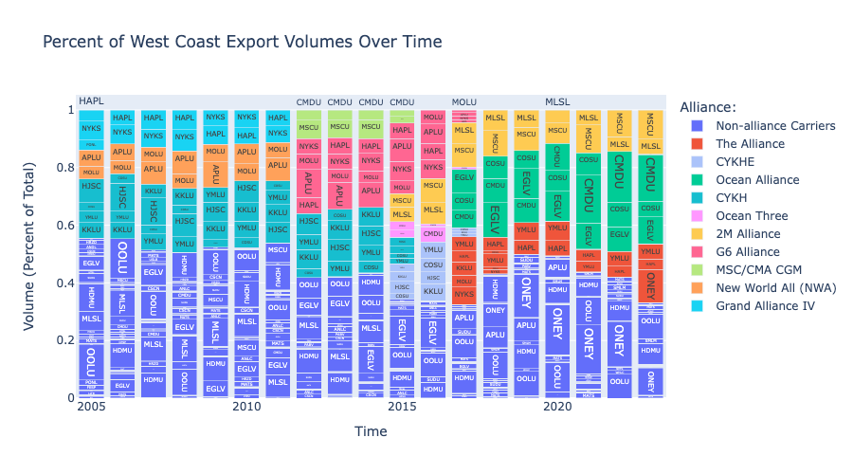

Slide 5
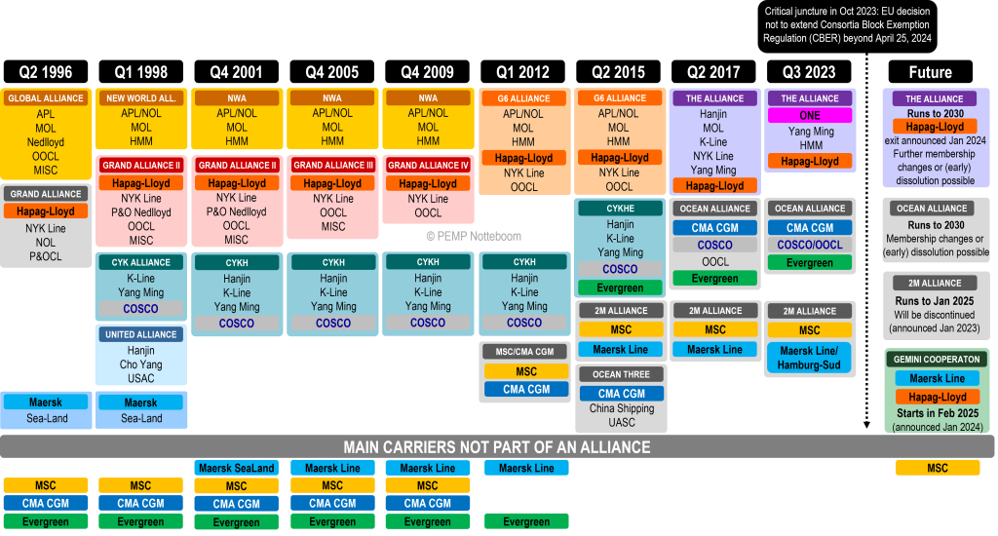
A Brief History of Alliances
Source: Theo Notteboom, PEMP

Slide 6
Do OCAs Reduce Competition?
Carriers argue that the increased efficiencies help keep costs down and allow them to provide better service.
Shippers and regulating bodies are concerned that OCAs give carriers too much market power
Anecdotal reports from US producers include high prices, reductions in frequency of service, and reduced delivery windows
Industry analysts point out that OCAs currently represent some ¾ of global capacity
OCAs have historically been exempt from antitrust regulation
This tide may be changing: EU exemption expired in April, and US is investigating similar moves

Slide 7
WSU Transportation Research Group
USDA Grant
This research is supported by the U.S. Department of Agriculture, Agricultural Marketing Service. The findings and conclusions in this publication are those of the authors and should not be construed to represent any official USDA or U.S. Government determination or policy.
Investigating impacts of OCAs on Containerized Ag Exports
Price
Quality of Service
Service Frequency (number of voyages, total capacity)
Competitive Options (number of carriers servicing a given lane)
Premise: Impacts of OCAs depend on how much carriers utilize the OCA
To our knowledge, this has not been studied

Slide 8
Data Sets
S&P Global’s PIERS database
Bill of Lading level data including volume, date, arrival and departure ports, commodity codes, vessel IDs (IMO codes), etc.
Dataset captures all maritime containerized freight bills processed by US Customs since 2005
Excludes trade via air, truck, rail, Canadian and Mexican borders, etc.
~179M import bills, ~70M export bills
Alliance Membership Data
Referencing the work of Port Economics, Management and Policy’s Theo Notteboom
Future analysis will include Drewery’s Container Insights price data
Average prices per TEU for a given lane and month

Slide 9
West Coast Exports
Since we are initially focused on the impacts of OCAs on US producers and this is PNREC, this presentation presents data from US West Coast ports only.

Slide 10

Measuring OCA Utilization
OCAs are not utilized on all lanes, and utilization varies over time.
Premise: Impacts of OCAs on a given lane are proportional to utilization
We are developing a metric for OCA utilization based on cargo sharing behavior
$$Alliance Utilization = \frac{Capacity Shared with Allied Carriers}{Total Capacity Shared}$$

Slide 11
Cargo Sharing
We define a vessel’s ”Primary Carrier” as the carrier representing the most cargo carried on that vessel in any given month.
“Shared Cargo” is the cargo carried on a vessel not from the primary carrier.

Slide 12
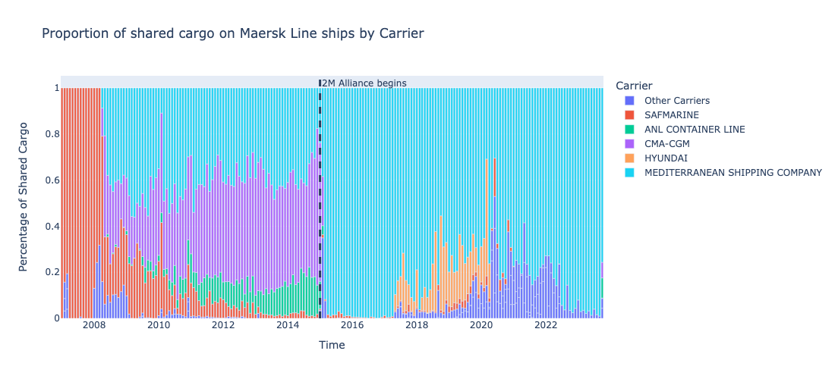

Slide 13
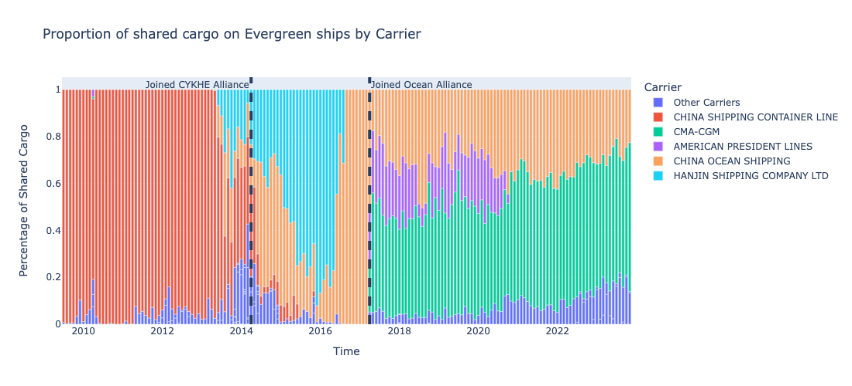

Slide 14
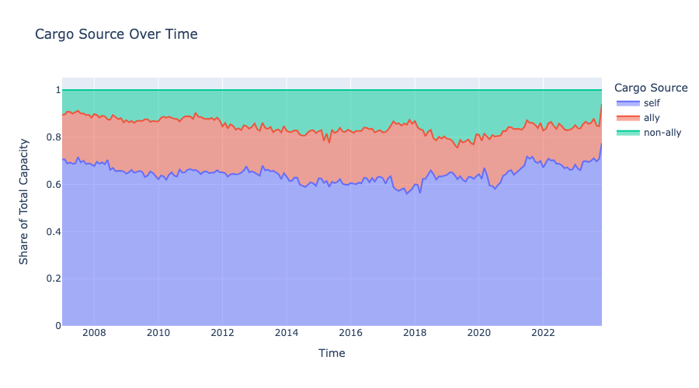

Slide 15
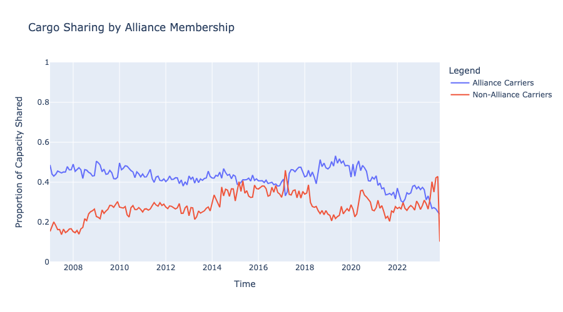

Slide 16
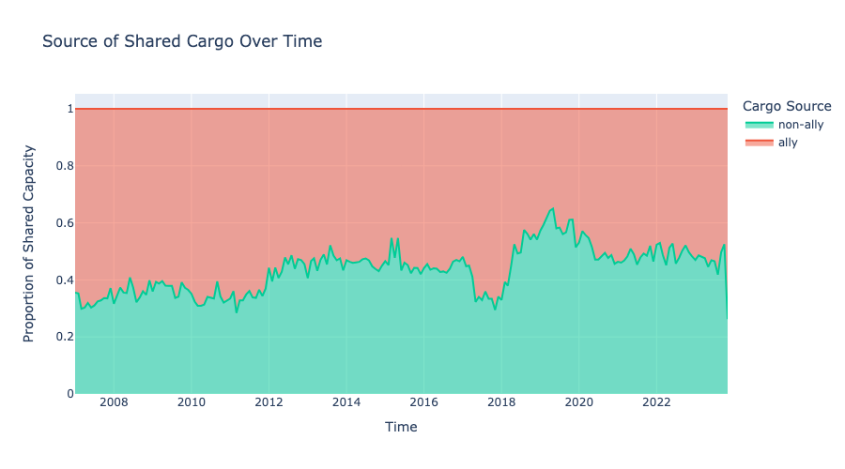

Slide 17
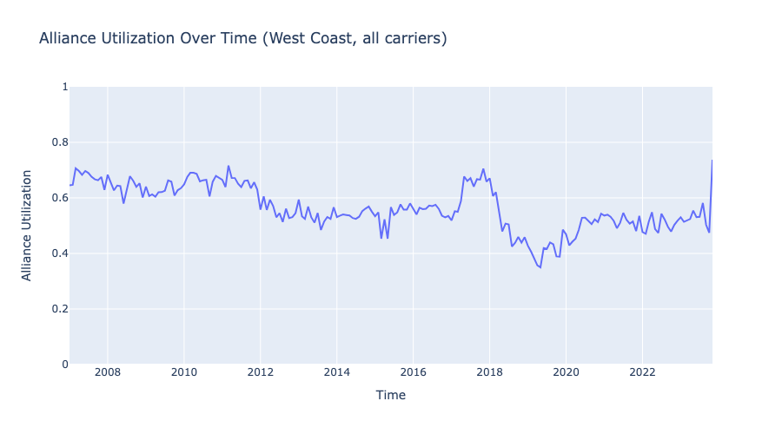

Slide 18
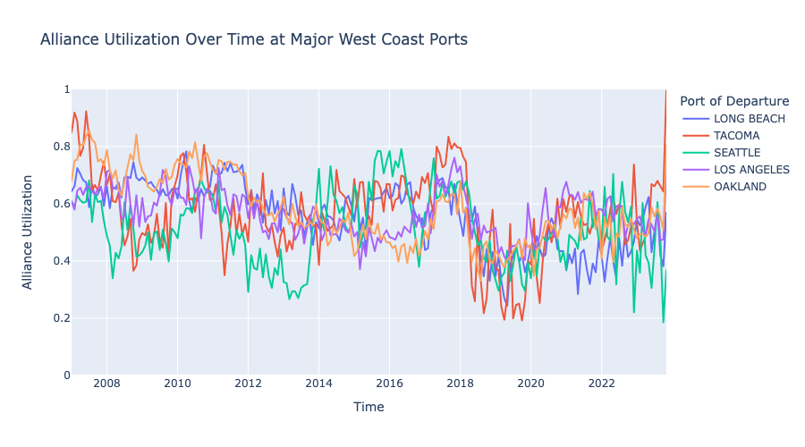

Slide 19
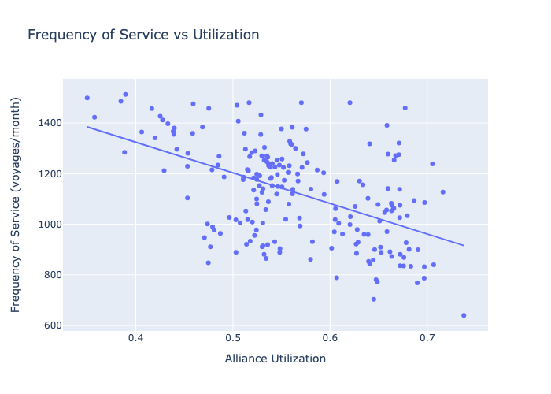

Slide 20
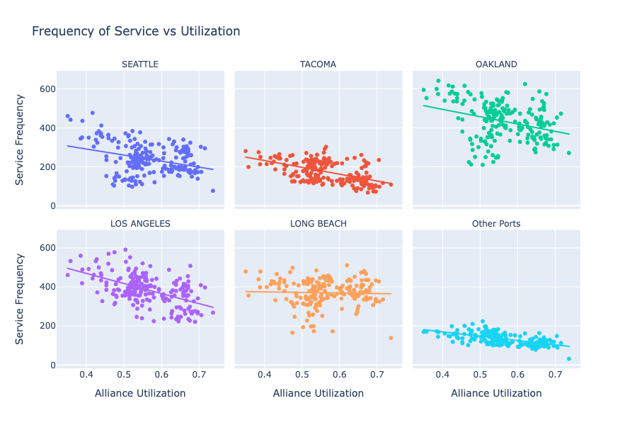

Slide 21
Limitations
The PIERS data do not include empty haul
OCAs are only one form of vessel sharing agreements (VSA); we do not observe any other form of VSA.

Slide 22
Concluding Remarks
Alliance utilization varies over time and across lanes
Impacts on producers depend on utilization
Study results re: US ag producers expected this fall
Questions and comments welcome!
adam.wilson1@wsu.edu

